Slide 1

Quick Cart Application Overview
A seamless application for ordering food and groceries Group – 39

Slide 2



Meet the team
Rhitik 002414623
Harsha 002379909
Sai Sridhar 002312170

Slide 3

Introduction to Quick Cart
Quick Cart is a Java-based application that provides customers with a streamlined experience for ordering food and groceries. The application involves multiple user roles: Customer, Restaurant Manager, Chef, Delivery Manager,Delivery Boy, Grocery Manager,Inventory Manager, Restaurant Admin, and Grocery Admin.

Slide 4
Quick Cart Workflow
1. Customer logs in or registers.
2. Customer selects Restaurants or Grocery Stores.
3. Browses outlets, views menus, and places an order.
4. Restaurant Manager manages orders and assigns tasks.
5. Chef prepares the order.
6. Delivery Manager assigns delivery tasks.
7. Delivery Boy updates delivery status.
8. Customer tracks order and provides feedback.

Slide 5
Customer Features
1. Register and Login.
2. Choose between Restaurants and Grocery Stores.
3. Browse outlets and menus.
4. Place and modify orders.
5. Track order status.
6. Rate the order after delivery.

Slide 6
Restaurant Manager Features
1. Accept customer orders.
1
2. Assign tasks to cooks.
2
3. Monitor order preparation.
3
4. Assign orders to the delivery company.
4

Slide 7

Introduction to Grocery Module
The Grocery Module in Quick Cart is designed for customers to browse grocery stores, add items to the cart, and place orders seamlessly. The module involves multiple user roles: Customer, Grocery Store Manager, Inventory Manager, Delivery Manager, and Delivery Boy.

Slide 8
Grocery Module Workflow
1. Customer logs in or registers.
2. Customer selects Grocery Stores.
3. Browses stores, views available items, and places an order.
4. Store Manager processes the order and assigns delivery partner.
6. Delivery Manager assigns delivery tasks.
7. Delivery Boy updates delivery status.
8. Customer tracks order and provides feedback.

Slide 9
Customer Features
1. Register and Login.
2. Choose Grocery Stores.
3. Browse items and add to cart.
4. Place and modify orders.
5. Track order status.
6. Rate the order after delivery.

Slide 10
Grocery Manager Features
1. Accept customer orders.
2. Assign orders to delivery companies.
3. Monitor order preparation.
4. They can also request for inventory.

Slide 11
Inventory Manager Features
1. Send request for Grocery manager to be their supplier
2. Send inventory to grocery stores.

Slide 12
Delivery Manager Features
1. Login to the portal.
2. Assign orders to delivery boys.
3. Monitor order delivery process.

Slide 13
Delivery Boy Features
1. Login to the portal.
2. Assign orders to themselves.
3. Update delivery status as:
- 'Order Picked Up'
- 'Order on the Way'
- 'Delivered'

Slide 14
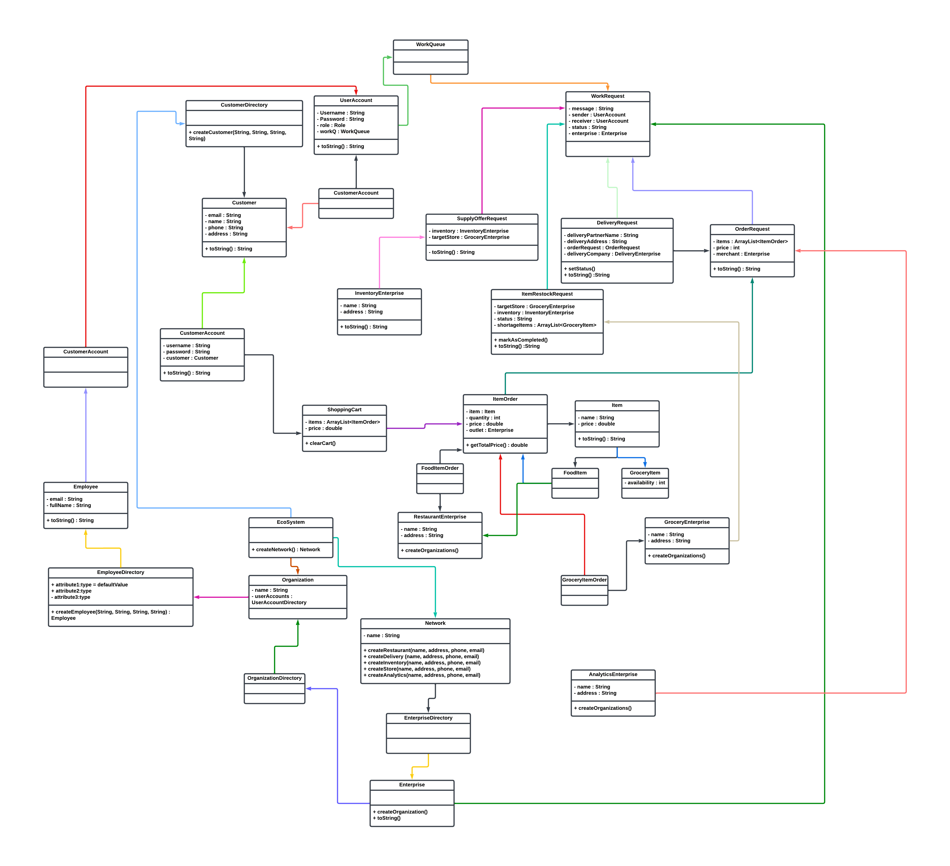
UML Diagram

Slide 15
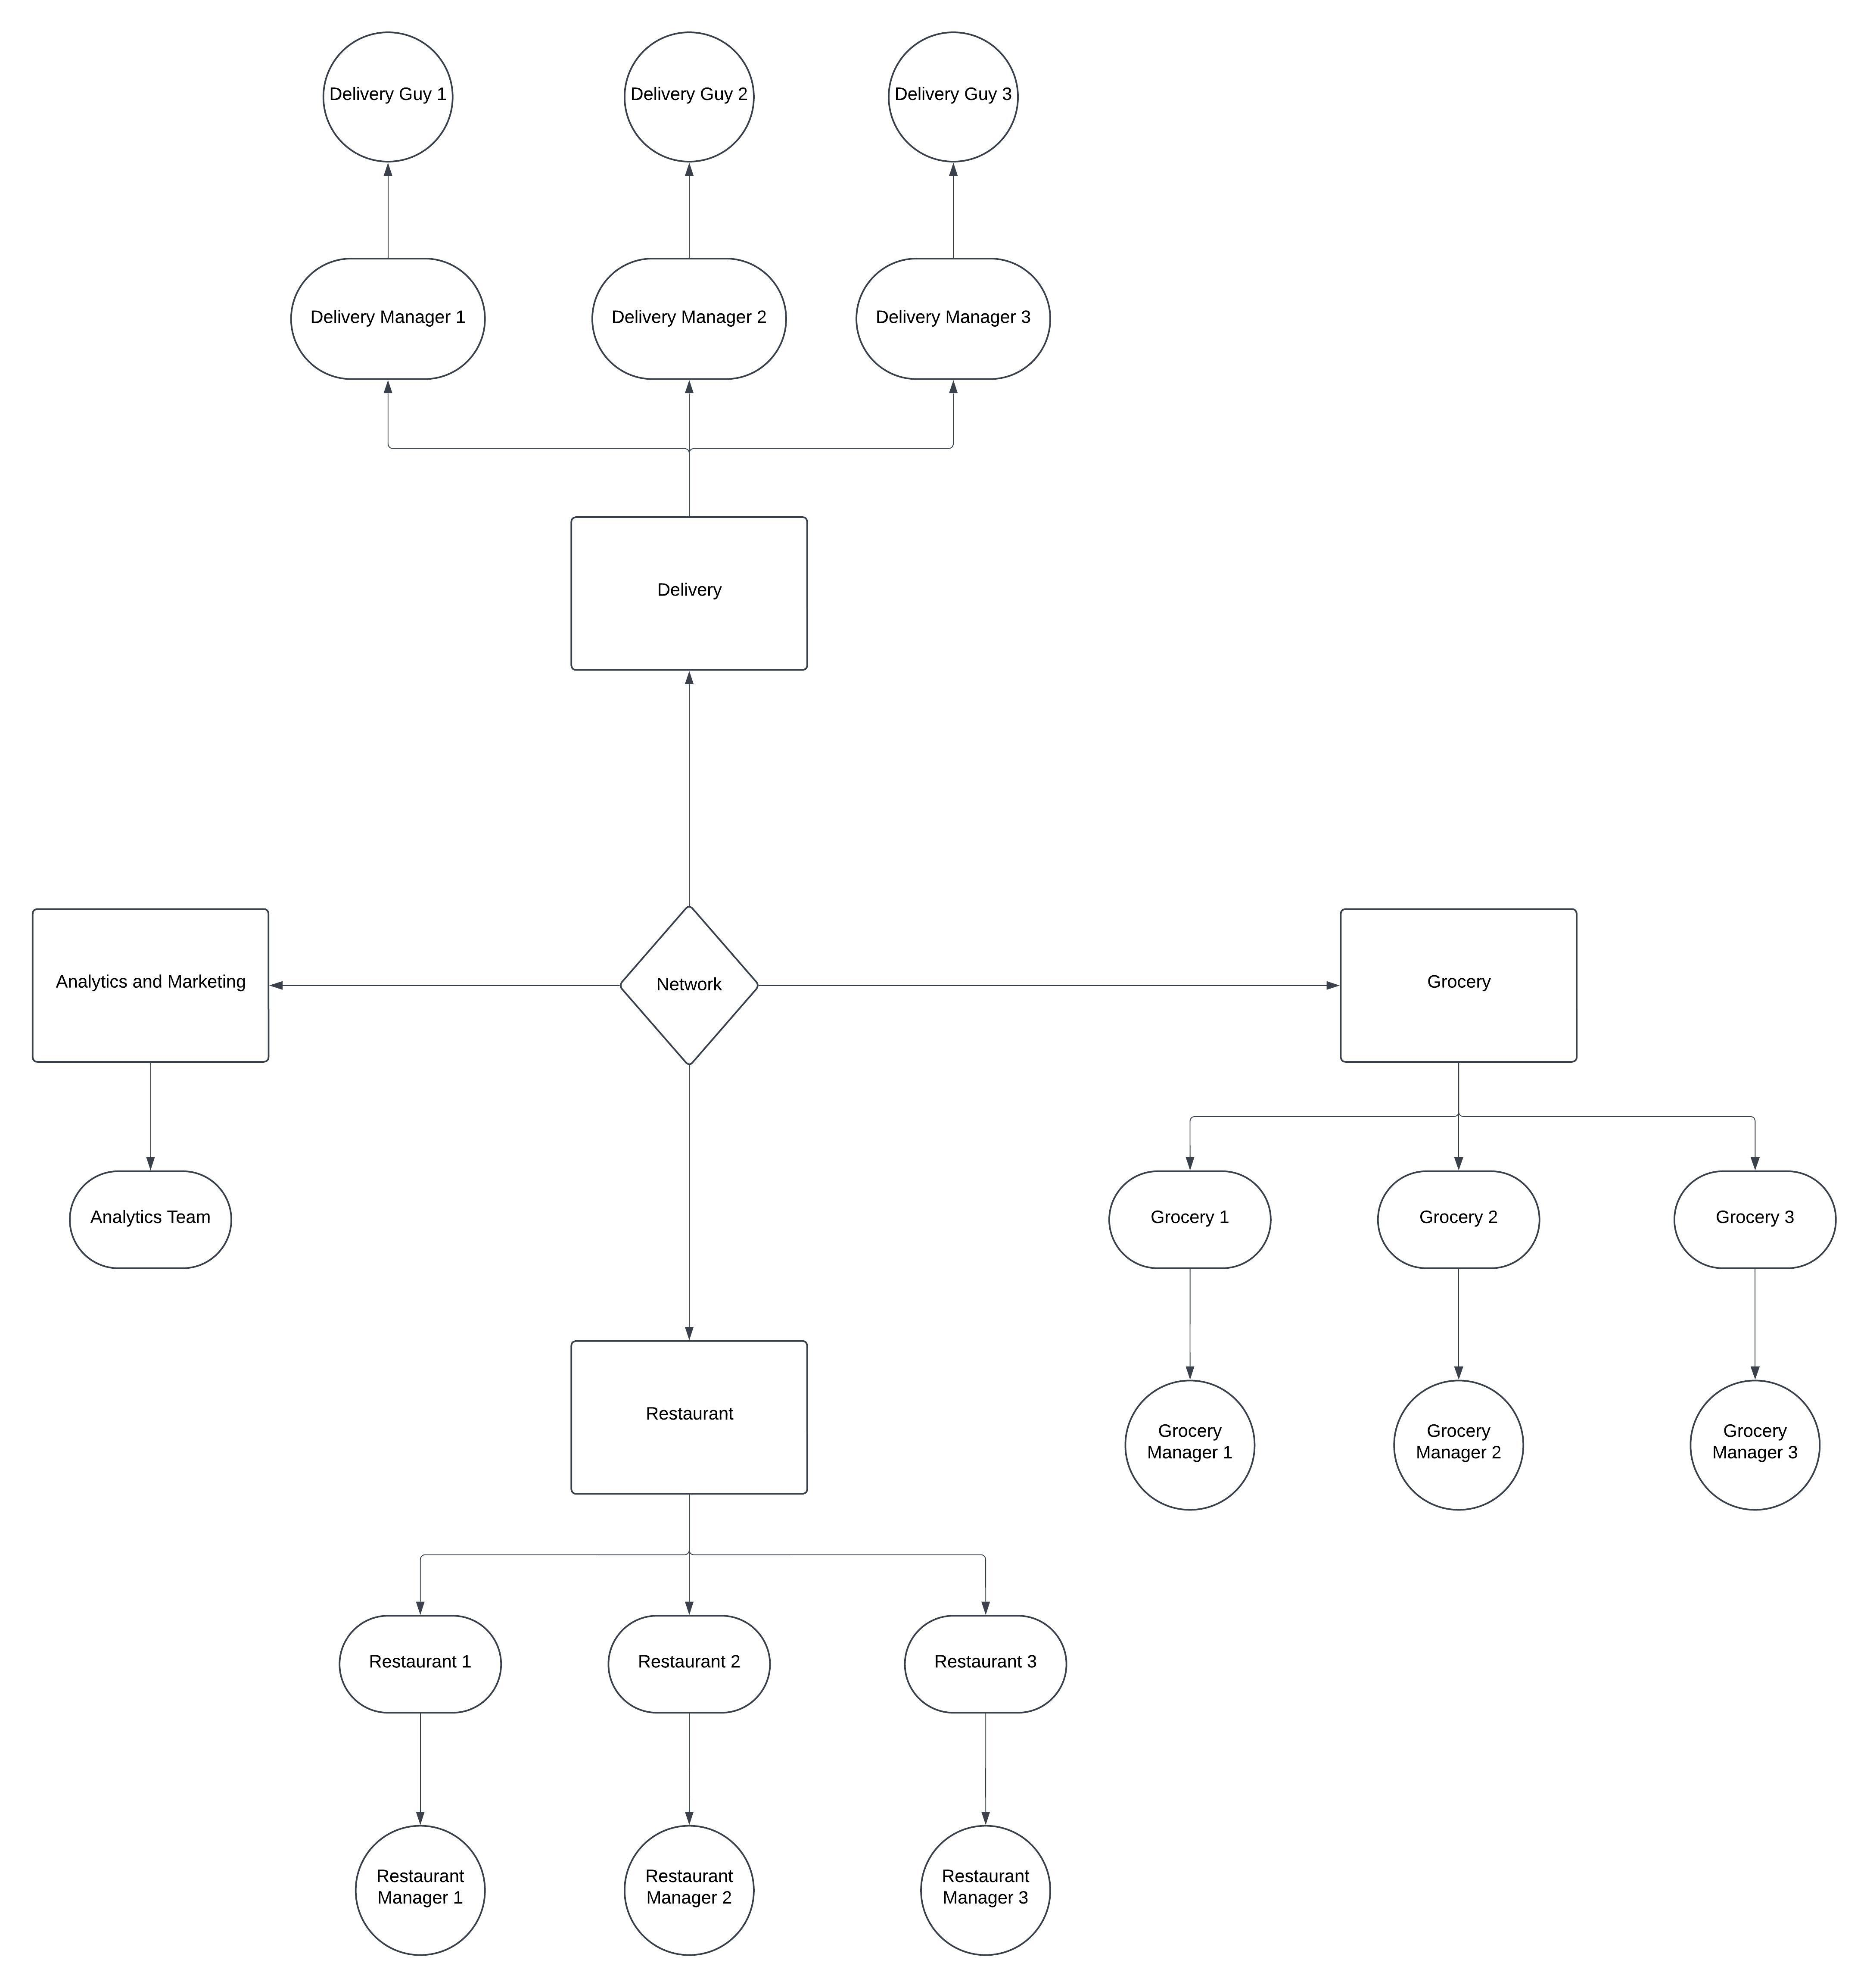
High Level Component Diagram

